Slide 1

Food Responsive ordering System
Team Members Harshath.U
Krithiga.R
Deepesh Kumar

Slide 2
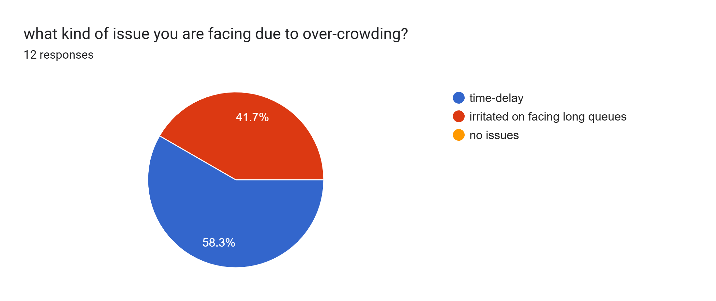
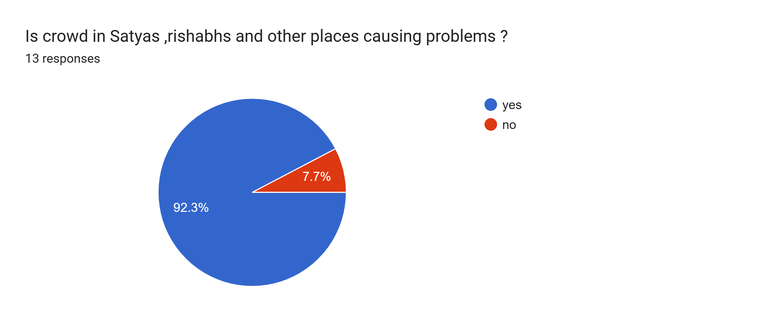
Problem statement
Over Crowding in Food Restaurants/canteens within the campus .

Slide 3
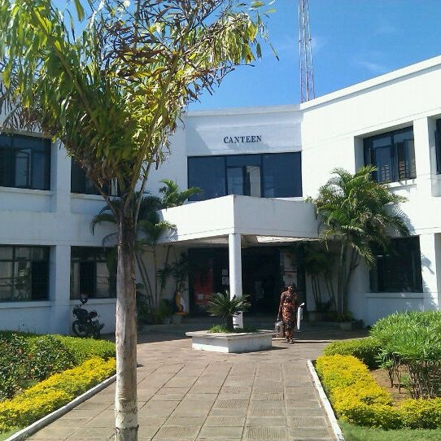
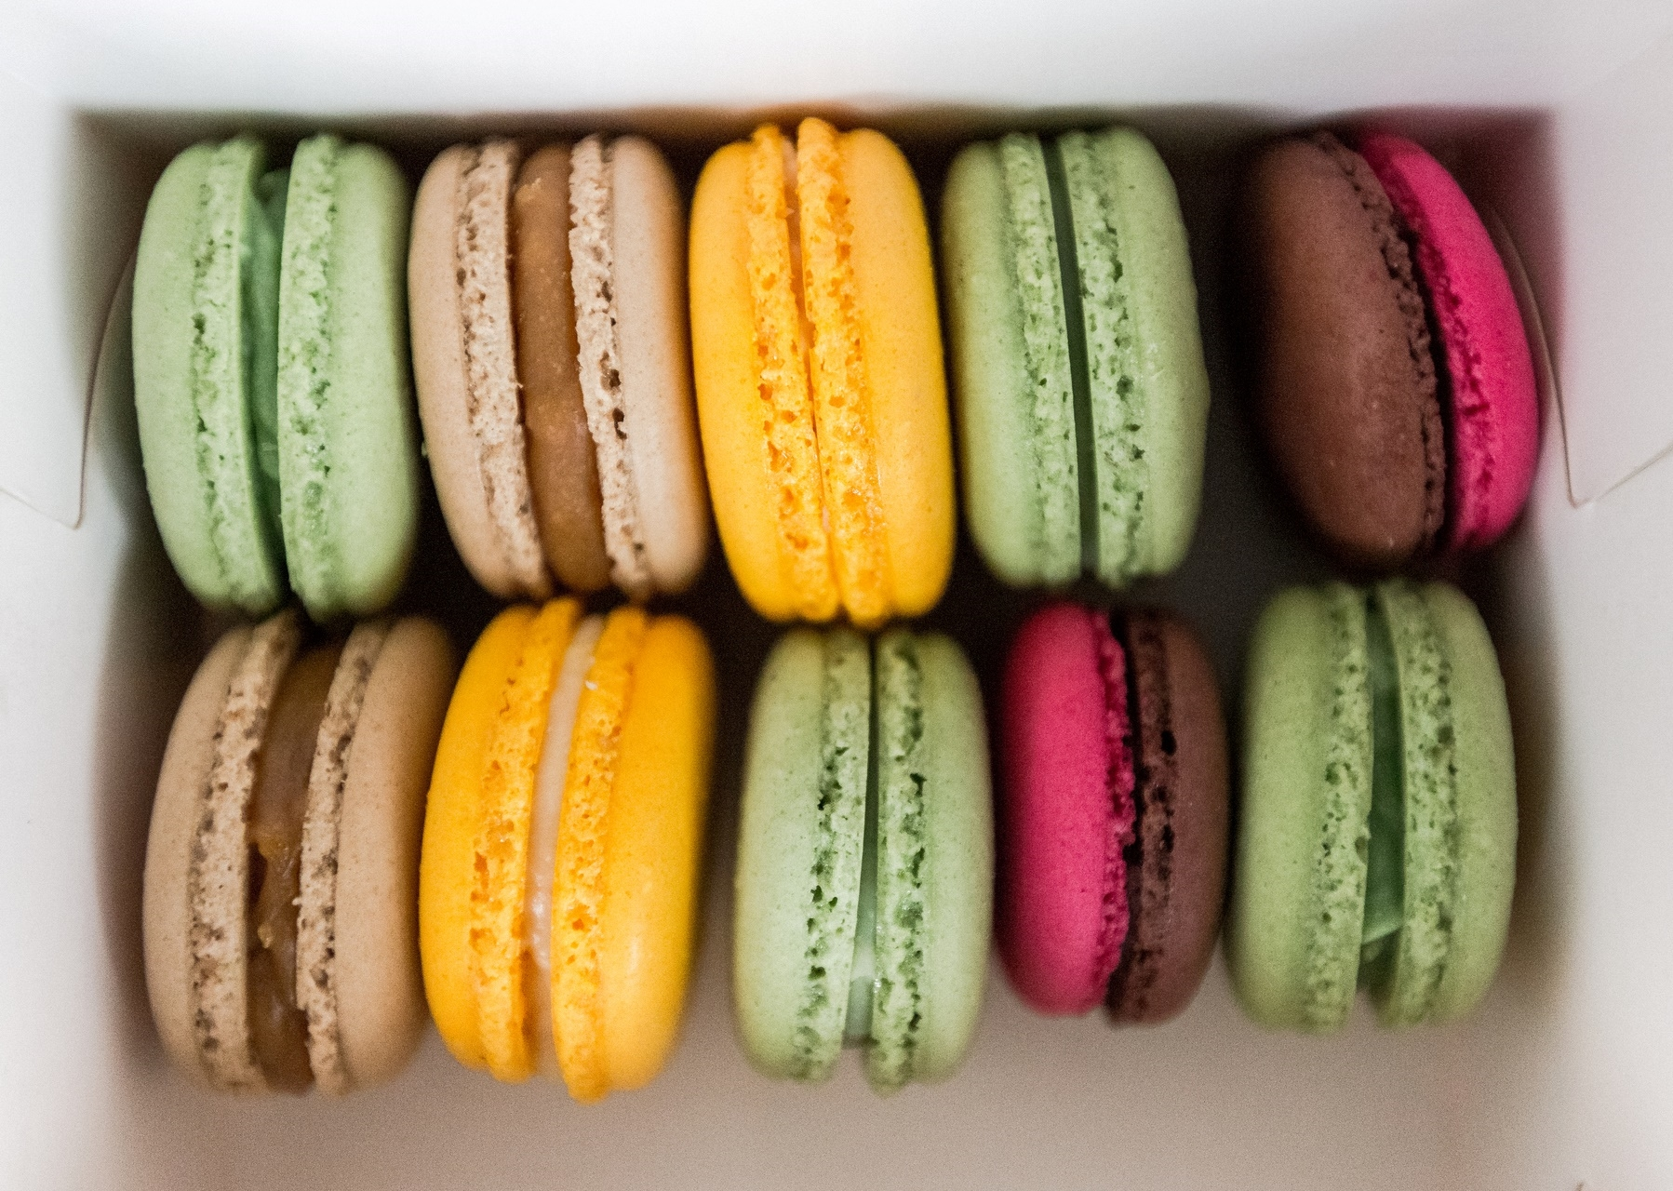
For whom?
For Students ,Faculty members who face difficulties due to over-crowding .
CLIENTS:
SSN/SNU Students
SSN/SNU Faculty members

Slide 4
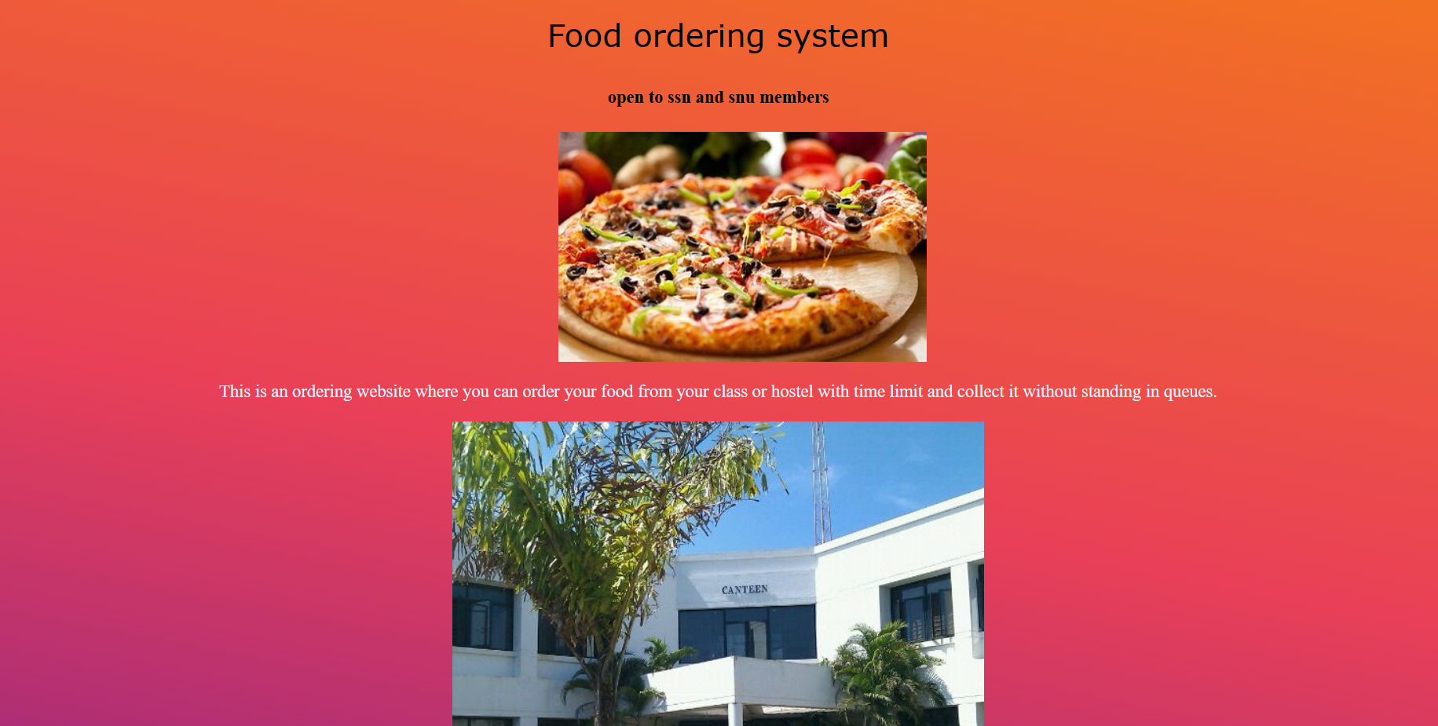
Solution
A webpage that contains a list of food items of all the shops present inside the campus is designed.

Slide 5


THANK YOU

